Slide 1


Distributed Systems Live Streaming App
By Pádraig Crotty (20085012)

Slide 2
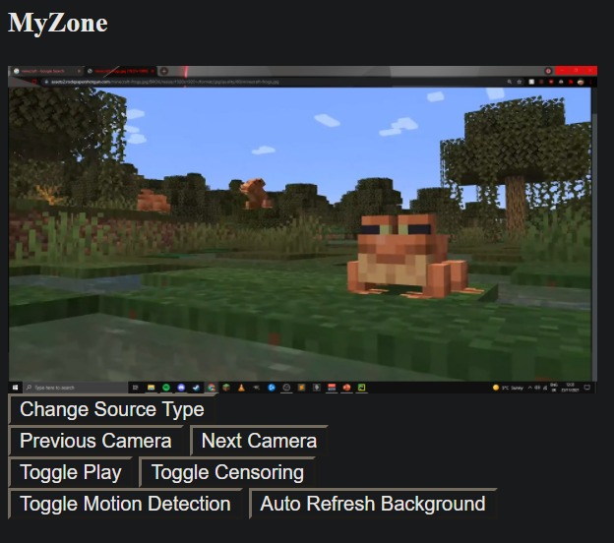
Welcome to MyZone
MyZone is a prototype app for helping streamers, lets get into it!

Slide 3




Technologies used in creation
The App was made in Python
There were 5 primary technologies used:
Waitress
Flask
OpenCV
NudeNet
Pillow

Slide 4
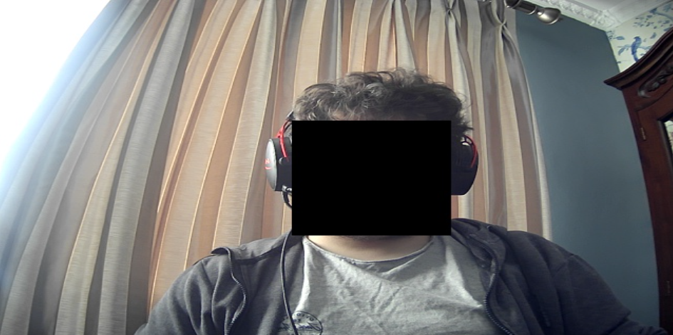
So how does MyZone help?
Using NudeNet we can censor a variety of NSFW content (and Faces!)
Here I have censored my face as an example:

Slide 5
It also has motion Detection!

Slide 6
Enough talk, Let’s Demo!

Slide 7
Any Questions?

